Slide 1
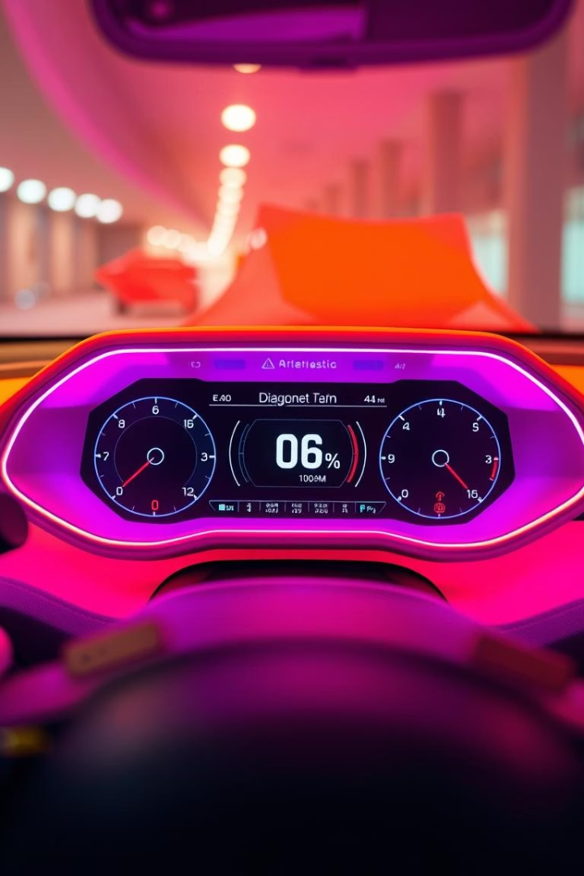
Requirement Analysis for Car Fault Management System
PRESENTED BY GROUP16
Course title: CEF 440
Course Instructor:DR Nkemeni Valery

Slide 2
INTRODUCTION
Project Overview
The objective of the requirement analysis phase is to bridge the gap between what
stakeholders need and what the technical team will build. This involves gathering,
analyzing, prioritizing, and validating all requirements related to the system’s
performance, functionality, and usability.
Project Goal
Requirement Analysis Purpose
Develop a robust vehicle fault diagnostic system using sensor networks and ECU communication protocols.
Bridge stakeholder needs with technical implementation by gathering, prioritizing, and validating system requirements.
Outcome
A validated Software Requirements Specification (SRS) that guides system design and development.

Slide 3
Literature Review: Foundations of Requirement Analysis
Key Concepts
Standards and Techniques
Functional vs. Non-Functional Requirements
IEEE Standard 830 for SRS structure
Importance of completeness, clarity, and validation
Validation methods: reviews, prototyping, use case modeling
Stakeholder involvement for accurate requirement capture
Automotive protocols: OBD-II, CAN bus compliance

Slide 4

Methodology: Requirement Review and Feasibility
Completeness & Clarity
Technical Feasibility
Dependency Relationships
Addressed missing details like engine sound capture, fault confirmation, and classification using AI models.
Ensured compatibility with smartphones, offline functionality, scalable fault detection, and real-time alerts.
Identified critical system dependencies such as sound detection, database management, user alerts, and authentication.

Slide 5
Category | Item | Missing / Concern | Solution Summary | Updated Requirement
Completeness | Sound capture | No detail on how engine sounds are recorded | Use a built-in microphone on the user's mobile device to record engine sounds. | Users can either manually upload sound recordings via the app or enable automatic real-time
 | Fault reporting | No clear process for confirming/submitting detected issues | Auto-filled fault form + confirmation pop-up (“Report to mechanic?”) | Users will receive fault notifications and can confirm or cancel the alert it’s sent
Clarity | Fault vs. normal distinction | No clarity on how sounds are classified | Document process with flowcharts/UML | System uses AI to classify recordings via pattern recognition against labeled samples
 | Comparison & alert flow | Unspecified alert-trigger logic | Threshold-based logic (e.g. >80% critical); define backend steps: record → compare → alert → confirm → notify | If model finds >80% critical probability, it sends an alert for user confirmation
Feasibility | Diverse audio dataset | How to gather varied engine sounds | Partner with repair shops/manufacturers; crowdsourcing; continuous learning via user submissions | Train on large, diverse dataset—expand continuously through user input and industry partnerships
 | Hardware compatibility | Mic variation across devices | Optimize for iOS/Android built-in mics; offer optional affordable external hardware | Support smartphone recording by default; provide low-cost mic accessories for higher accuracy
Dependencies | Sound detection ↔ Analysis | Recording & model must both work correctly | — | If sound capture or model fails, the end-to-end detection flow breaks
 | Authentication ↔ Access control | Role-based access must be enforced | — | Only authenticated users with proper roles can view or upload fault data

Slide 6
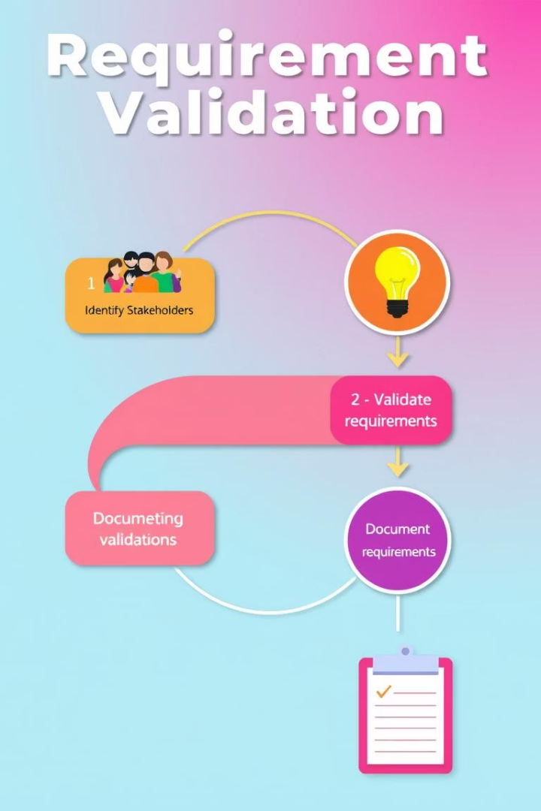



Identifying and Resolving Ambiguities and Gaps
Ambiguity Resolution
Defined measurable targets for accuracy, response times, and reminder logic.
Missing Information
Specified model update mechanisms, data management policies, and error handling procedures.
Inconsistencies
Clarified optional features like mechanic locator and video tutorials with offline considerations.

Slide 7
Category | Original Requirement Text | Issue Description | Suggested Resolution
Ambiguity | “High diagnostic accuracy” | Subjective; no baseline or target | Define measurable targets (e.g., ≥90% for lights; ≥85% for sounds)
Ambiguity | “Quick responses (within seconds)” | Vague timeframe; varying complexity | Specify SLAs: light-scan ≤2s; audio analysis ≤4s on standard devices
Ambiguity | “Timely maintenance reminders” | Triggers undefined (date, mileage, severity) | Clarify logic: immediate for high-urgency; routine every 6 months/5,000 km
Ambiguity | “User-friendly interface” | Qualitative; no specific usability standards | Reference WCAG mobile guidelines; ≤3 taps to core features
Missing | Model update / retraining mechanism | No process for updating on-device models | Define CI/CD for model training, validation, and secure in-app updates
Missing | Data management & storage | Unclear storage, retention, and purge policies | Define retention, cache limits, encryption, and deletion flows
Missing | User authentication & roles | No mention of accounts or roles | Add FRs: email/SSO login, password reset, RBAC for admin vs. user
Missing | Error handling & fallback UI | No guidance for scan failures or offline | Detail fallback: retry prompts, offline warnings, error logs
Inconsistency | Mechanic Locator described as “optional” | Survey suggests high value; unclear MVP inclusion | Decide MVP vs. v2; document in roadmap
Inconsistency | Video tutorials (“YouTube or embedded”) | Conflicts with offline requirement | Clarify online-only; provide text/PDF for offline use

Slide 8
Recommendations
Quantify Metrics: Set clear accuracy & latency targets (e.g., ≥90% accuracy, ≤3s).
Define Model Lifecycle: CI/CD for ML, secure in‑app updates.
Expand SRS: Add FRs for Auth, Error Handling & Data Privacy.
Clarify Scope: Tag features as v1 vs. v2; document in roadmap.

Slide 9
Prioritization and Classification of Requirements
High Priority (Must Have)
Medium and Low Priority
Dashboard Light Recognition
Mechanic Locator
Engine Sound Analysis
Notifications and Alerts
Repair Guidance & Maintenance Reminders
Customization Features
User Authentication and System Management

Slide 10
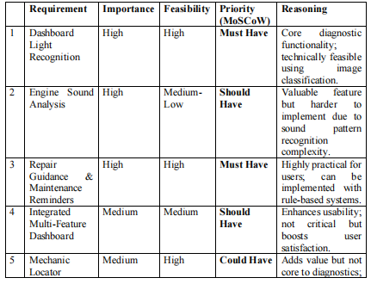
Prioritize Requirements Based on Importance

Slide 11
Functional and Non-Functional Requirements
Functional Requirements
Non-Functional Requirements
Dashboard light scanning and fault interpretation
Usability and performance under 3 seconds
Engine sound diagnosis and fault display
Reliability with 99.5% uptime
Maintenance reminders and mechanic locator
Security with encryption and access control
User account and notification management
Scalability and legal compliance

Slide 12

Stakeholder Validation and Conclusion
Final Approval
Validation Sessions
All key stakeholders formally approved the requirements, ensuring alignment and readiness for design phase.
Stakeholder Identification
Reviewed requirements, clarified ambiguities, and updated specifications based on feedback.
Included car users, technicians, system engineers, and marketing agents.
This requirement analysis establishes a solid foundation for developing a reliable, user-friendly car fault diagnostic system that meets technical and user expectations.

Slide 13
CONCLUSION
The requirement analysis for the automotive diagnostic system has been successfully
completed. Through stakeholder engagement and careful evaluation, we ensured all
functional and non-functional needs are clearly defined, feasible, and aligned with user
expectations. This analysis lays a strong foundation for system design and development,
minimizing future risks and ensuring project success.

